Slide 1


50 Days of Challenge
1) Current affairs Quiz app and Company Name Generator
2) Treasure Hunt application
3) Game simulator: Rock-Paper-Scissor app
4) Password (Strong) generator app
5) Mysterious maze escape app
6) Tea-vending machine (Using OOPs concepts)
7) Interactive Snake Game (GUI based)
8) Password manager app (using Tkinter)
NOTE: These are tentative projects, we will adapt according to your grasp of the concepts.

Slide 2
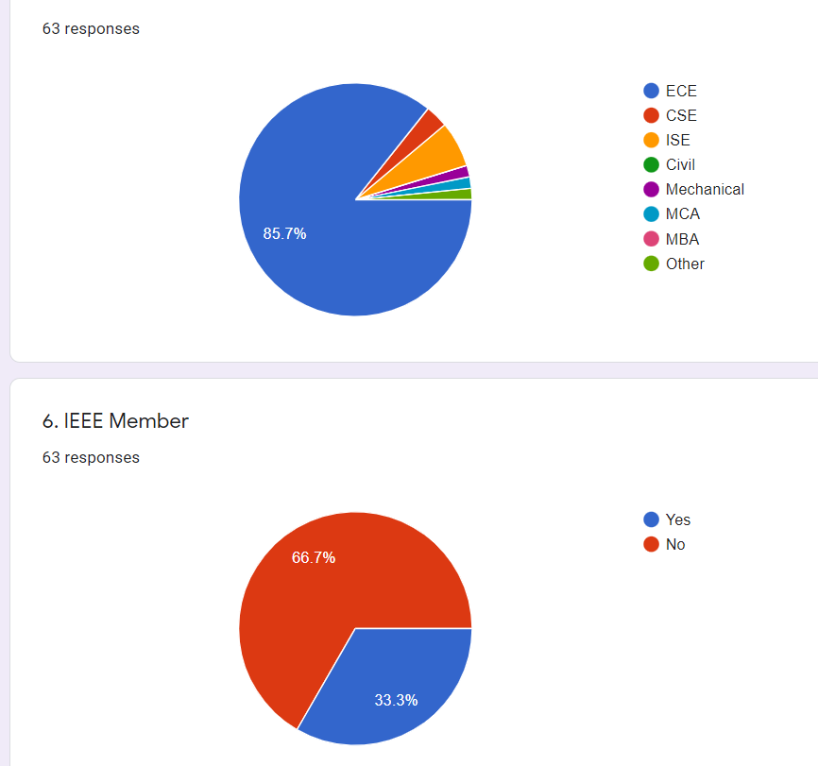
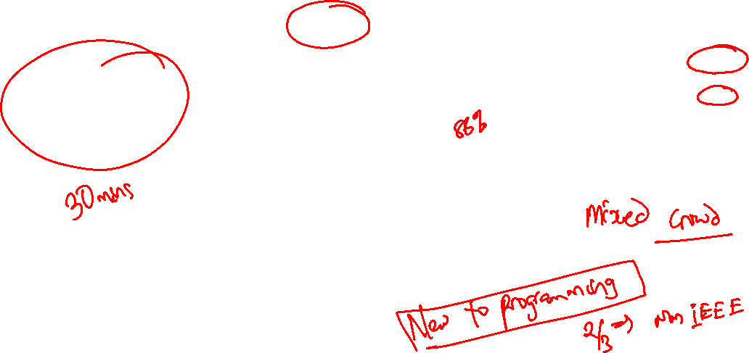
Where we stand?

Slide 3
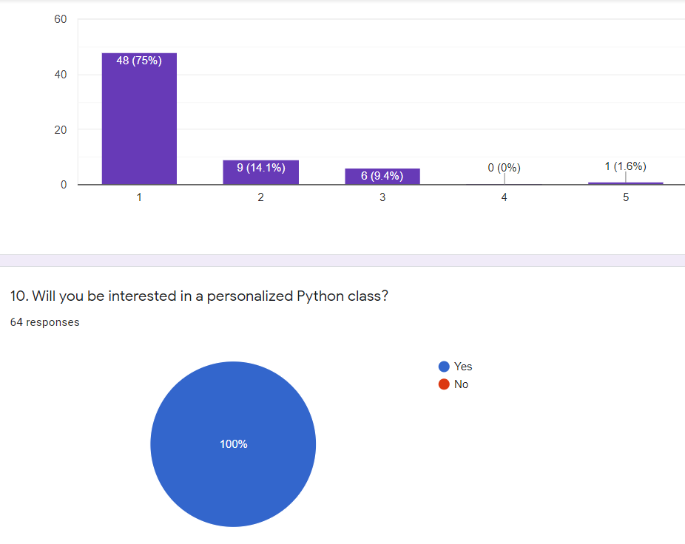
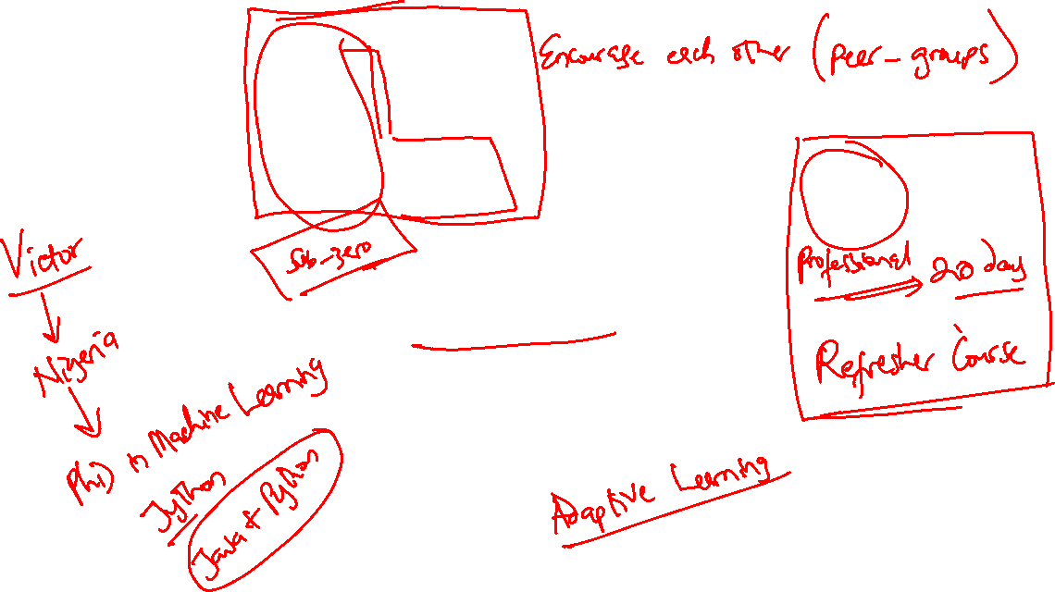

Slide 4
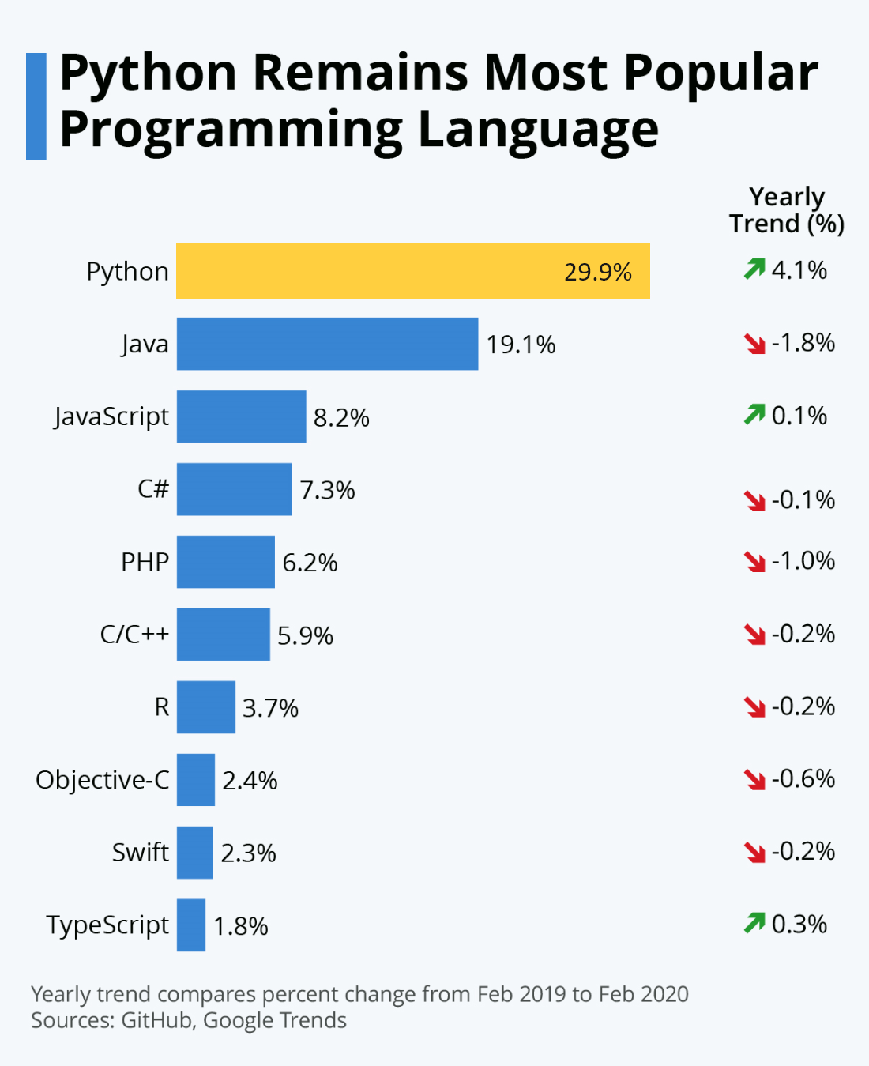
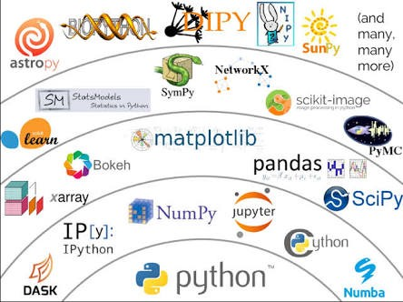
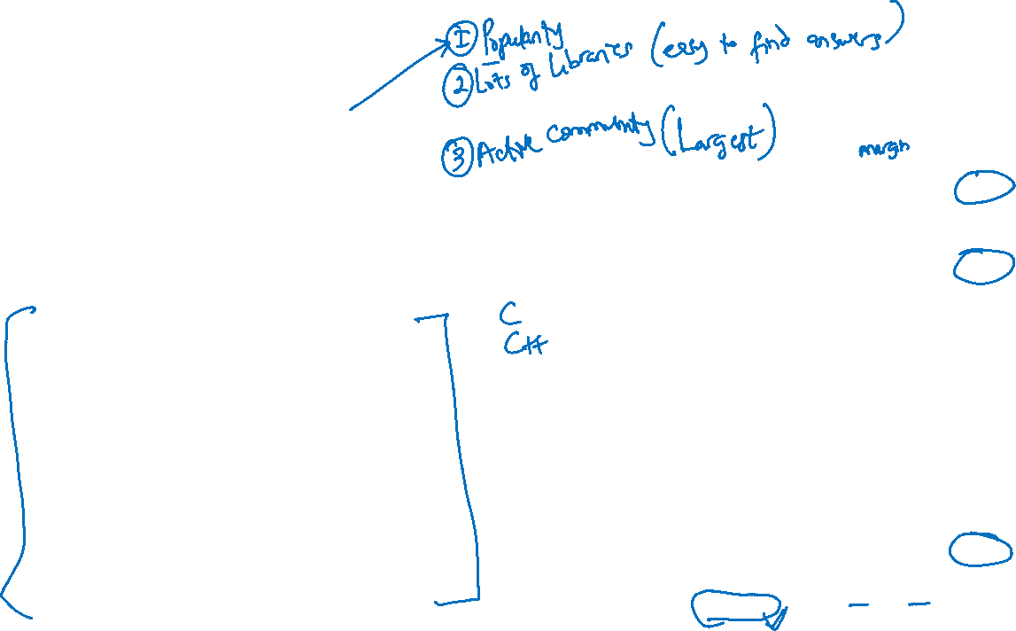
Why Python?

Slide 5
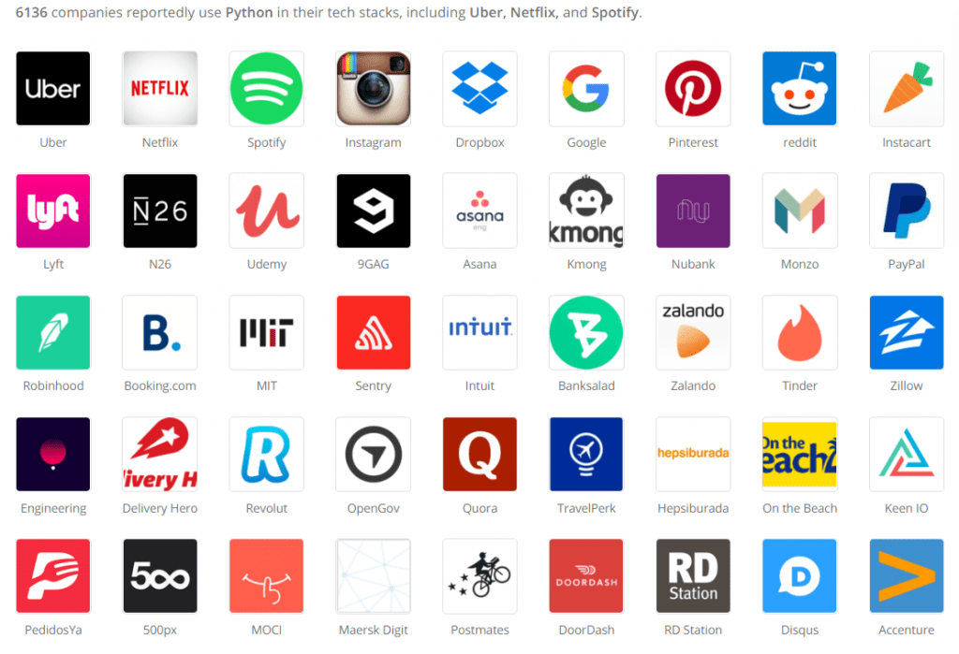

Slide 6
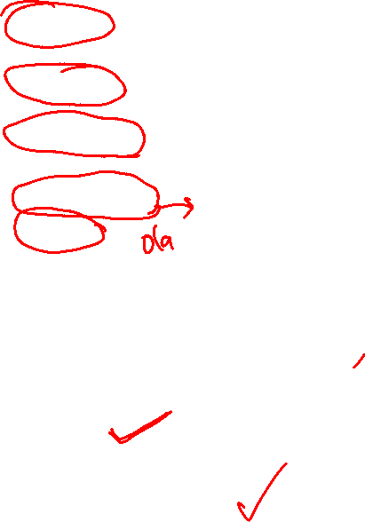
Top 15 websites developed in Python
Netflix: The world's most popular streaming website, was built with Python.
Google: Another popular website using Python is Google.
YouTube: A sister concern of Google, YouTube was majorly written in Python
Instagram
Uber
Pinterest
Dropbox
Quora
Spotify
Reddit
Yahoo
Instacart
Survey Monkey
Discus
Bitly

Slide 7

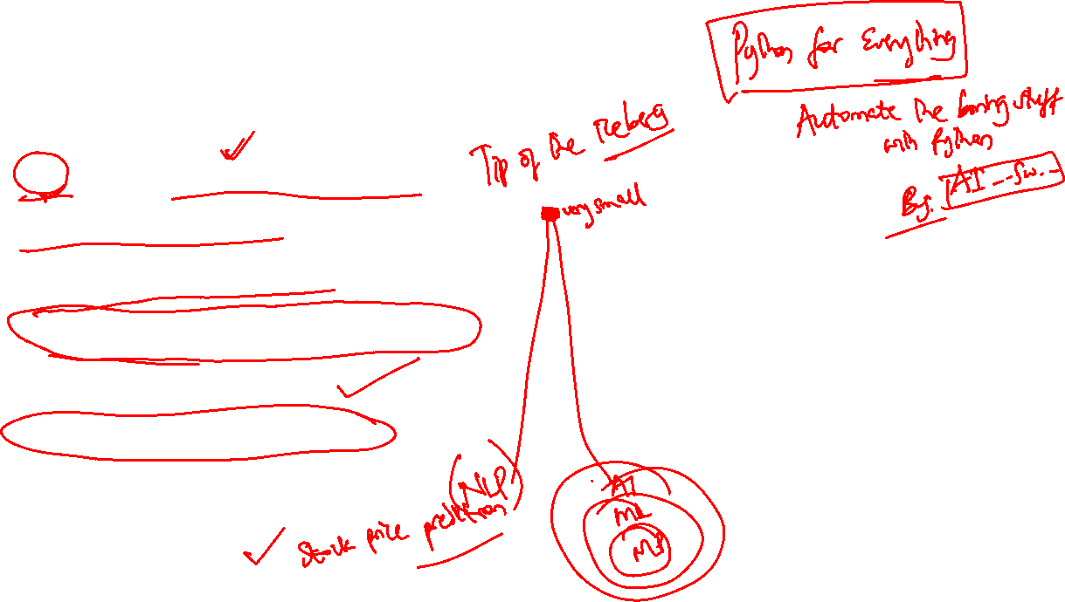
What can you do with Python?
Python can be used for:
AI and machine learning
Data analytics
Data visualization
Programming applications
Web development
Game development
Language development
Finance etc.

Slide 8
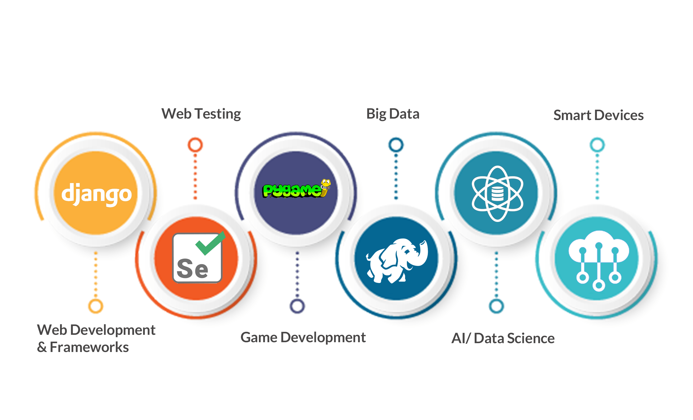
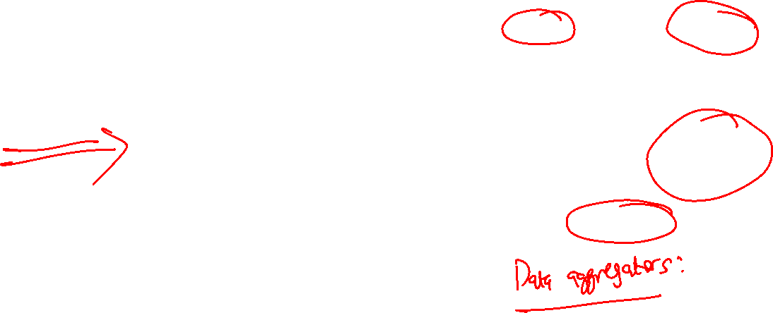
Career Path in Python

Slide 9
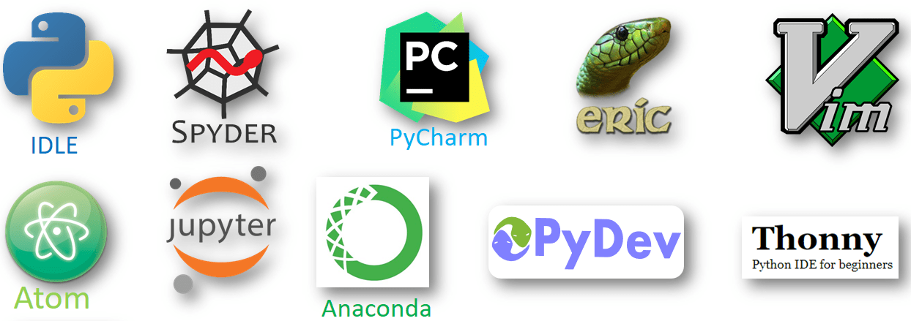
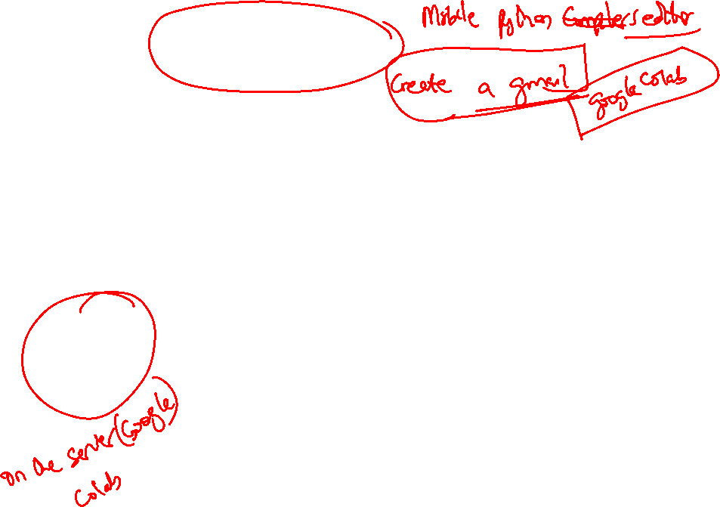
Python IDES vs Online IDES?

Slide 10
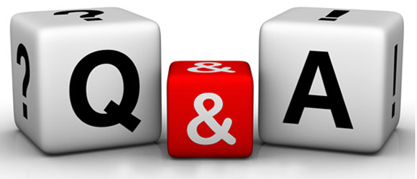
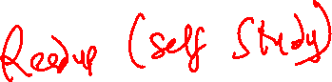
Anything Else?

Slide 11
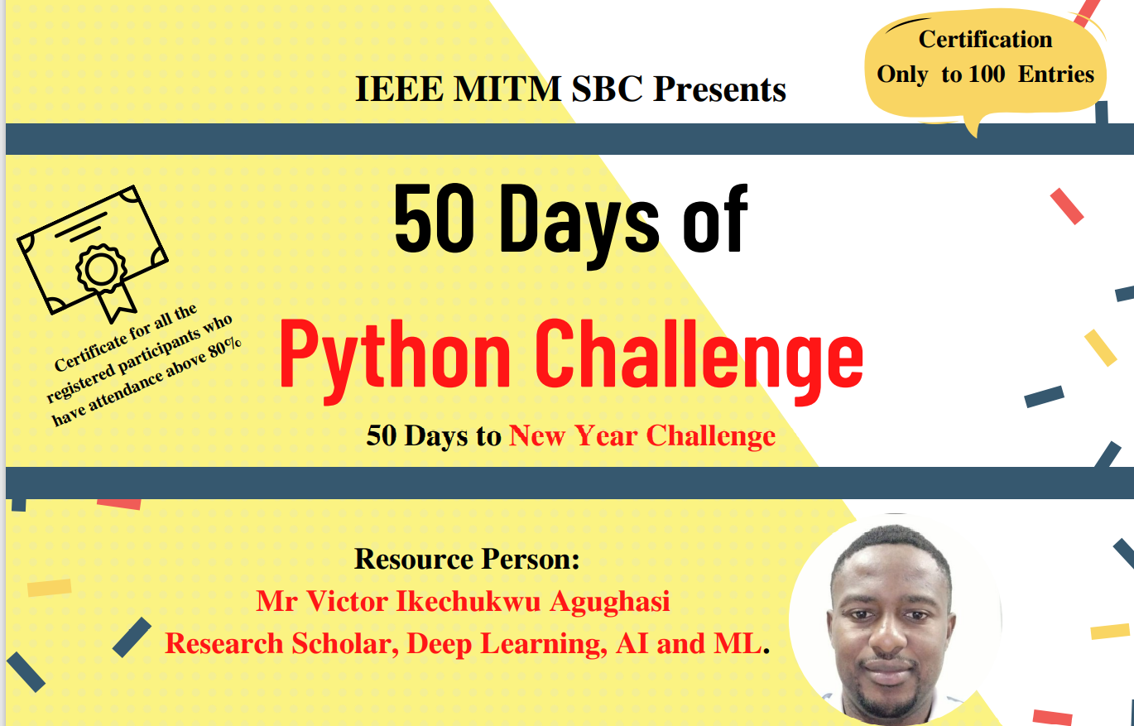
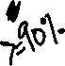

Slide 12
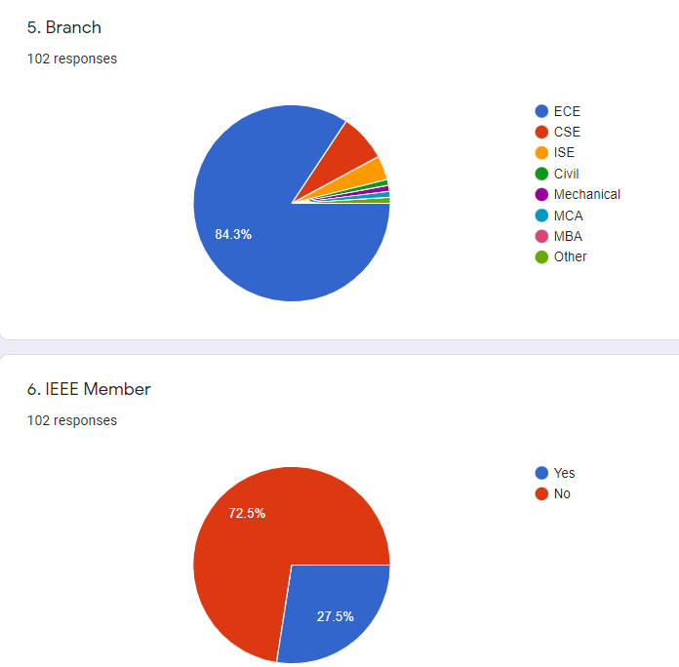
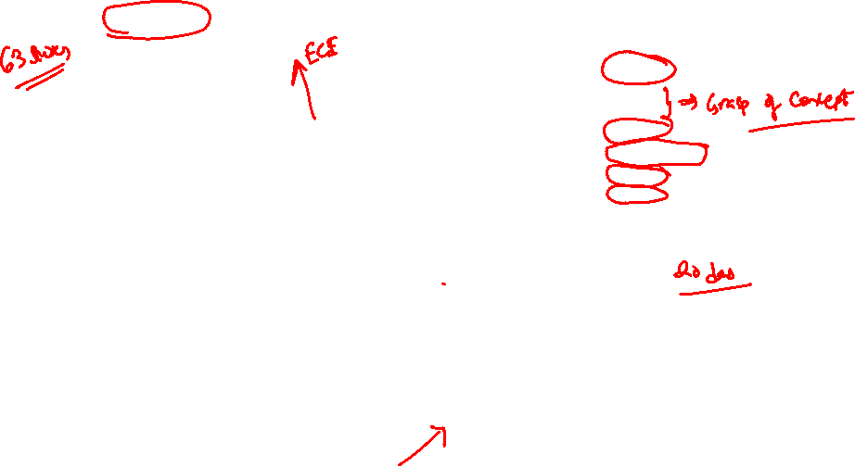
Where do we stand?

Slide 13
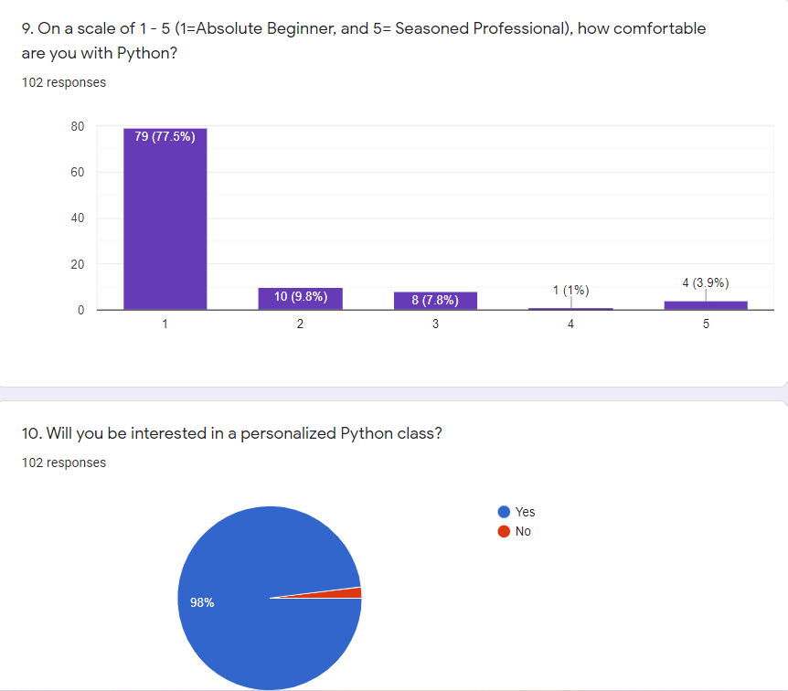
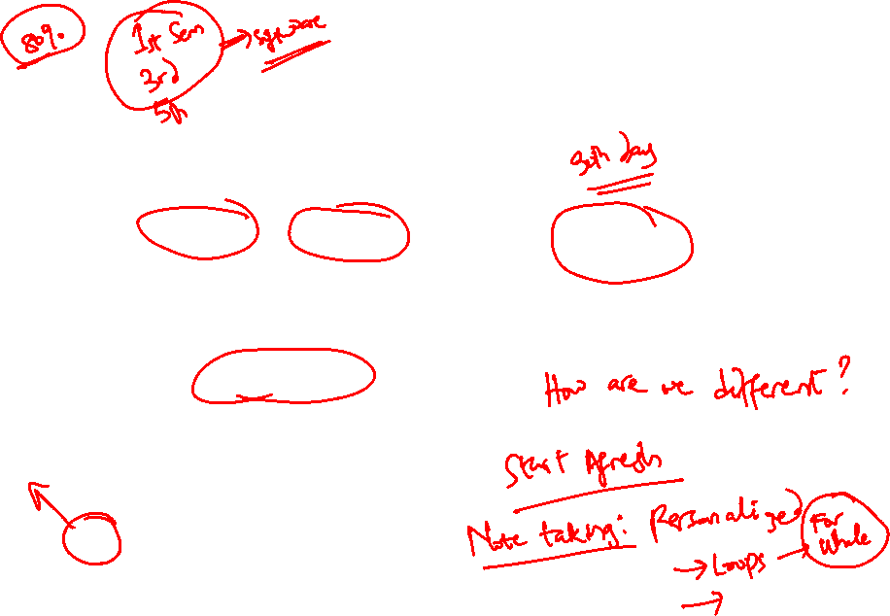

Slide 14
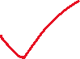
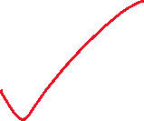
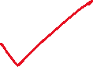
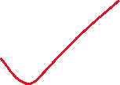
Day 2 of 50 Days to the New Year Challenge
OUTLINE
Python vs other programming languages
IDLE vs Online Compilers
Concepts of Variables, Strings, Keywords and naming rules
Demo:
Basic programs in Python

Slide 15
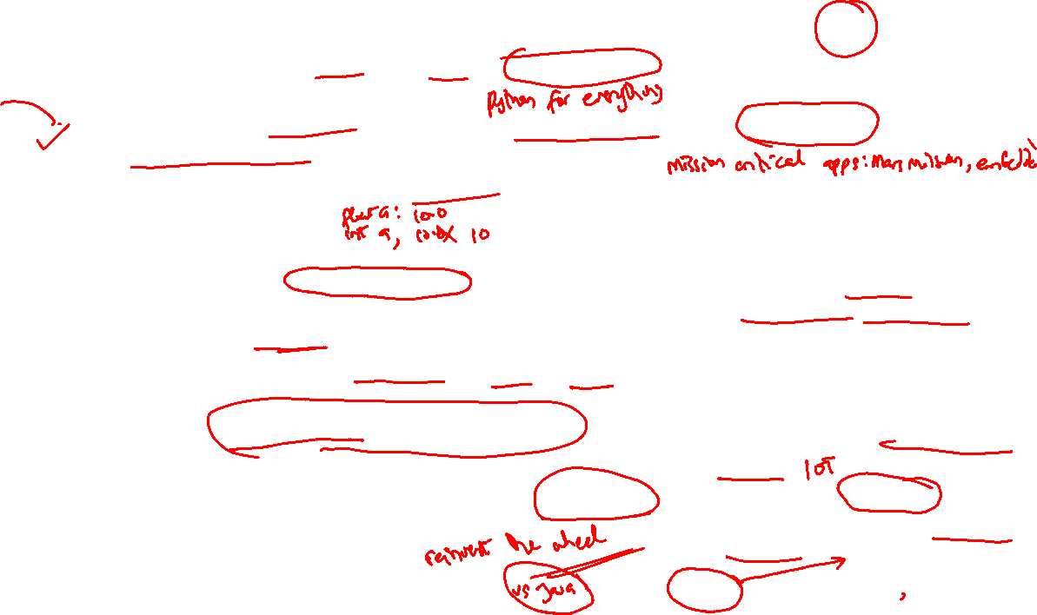
METRICS | Python | C
Introduction | Python is an interpreted, high-level, general-purpose programming language. | C is a general-purpose, procedural computer programming language.
Ease of Use | It is easier to write a code in Python as the number of lines is less comparatively. | Program syntax is harder than Python.
Speed of execution | Interpreted programs execute slower as compared to compiled programs. | Compiled programs execute faster as compared to interpreted programs.
Variables | There is no need to declare the type of variable. Variables are untyped in Python (Dynamically typed). A given variable can be stuck on values of different types at different times during the program execution | In C, the type of a variable must be declared when it is created, and only values of that type must be assigned to it.
Complexity | Syntax of Python programs is easy to learn, write and read. | The syntax of a C program is harder than Python.
Applications | Python is a General-Purpose programming language. | C is generally used for hardware related applications.
Data Structures | Gives ease of implementing data structures with built-in insert, append functions. | Implementing data structures requires its functions to be explicitly implemented
Pointers | No pointers functionality available in Python. | Pointers are available in C.

Slide 16
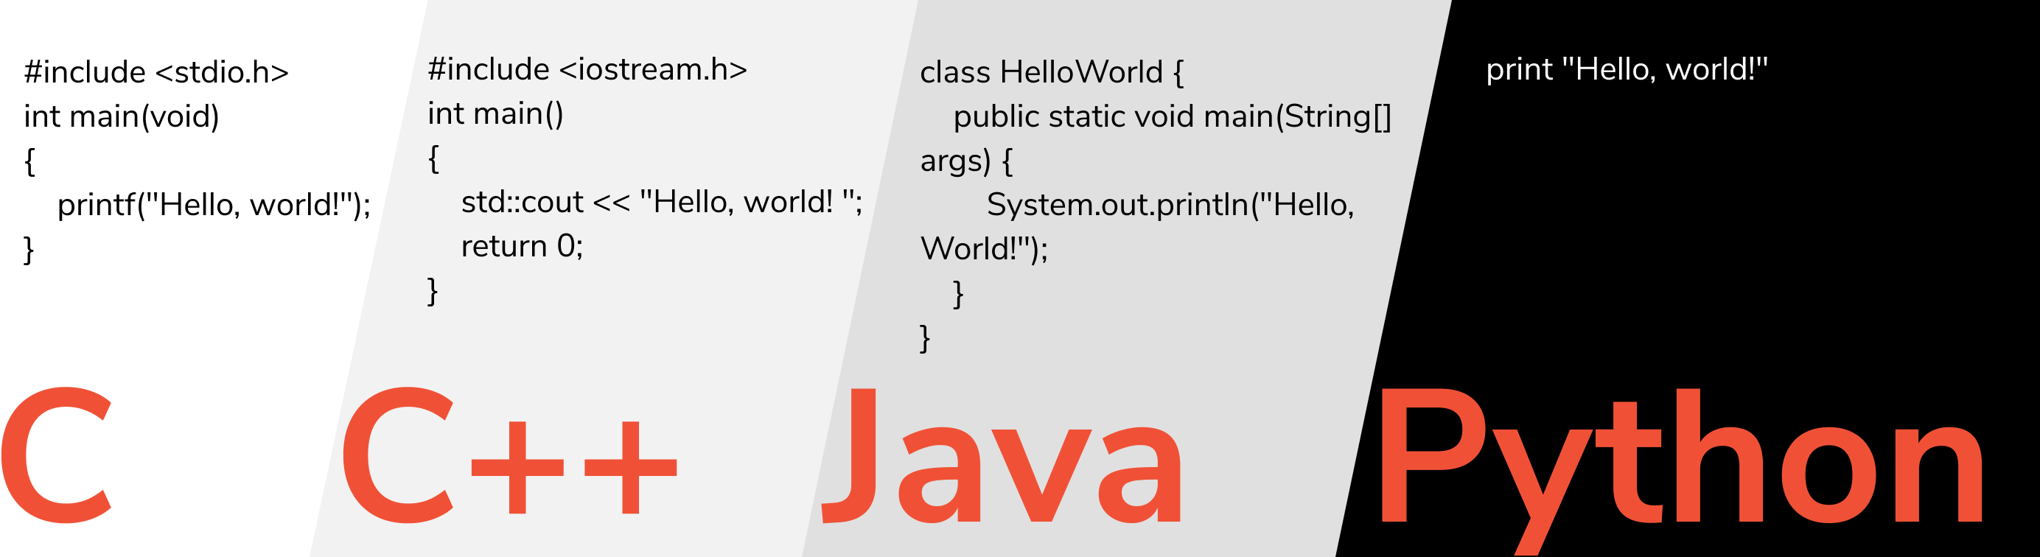
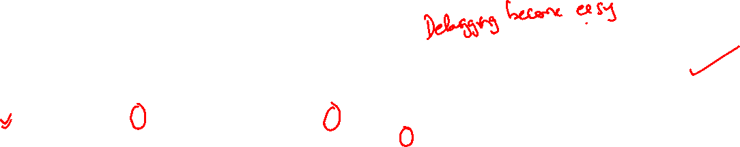
Python vs other languages

Slide 17
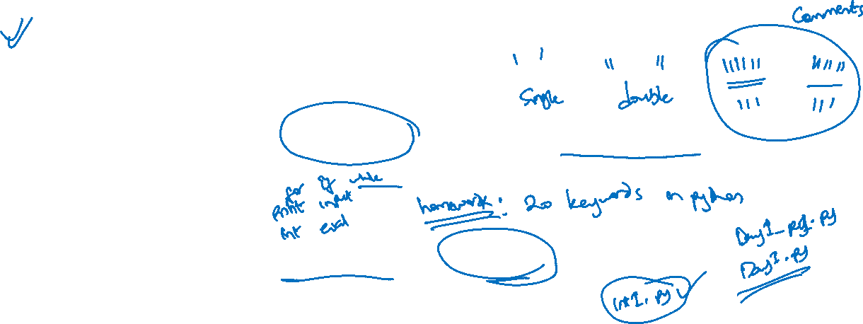
Variables, Strings, Keywords & naming rules
Variables: Values can be stored I variables to simplify calculations
Strings in python are surrounded by either single quotation marks, or double quotation marks.
'hello' is the same as "hello".
Python has a set of keywords that are reserved words that cannot be used as variable names, function names, or any other identifiers.
The name of a variable/filename must not be a Python keyword

Slide 18
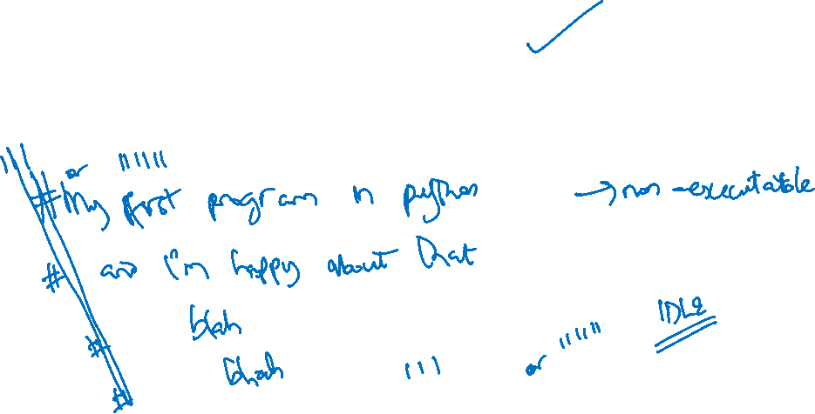
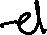
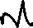
Comments in Python
Use of Single line Comment (#)
Multiline comments using triple quotes (“”” blah blah blah“””)

Slide 19


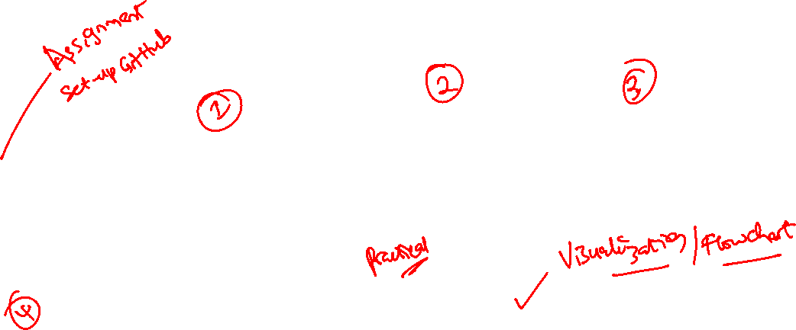






3 of 50 Days of Python Programming
OUTLINE
Python as a calculator
Use of magic variables
Keyboard Shortcuts
Getting user inputs
Demo / Homework
Flow Control

Slide 20
4 of 50 Days of Python Programming
1.) Magic Variables & Methods in Python
2.) Operators:
i)Comparative and Boolean (Truth Tables)
3.) Flow Control:
i)Conditions and Code Blocks
4.) While Loop:
i)Irritating and infinite loops
5.) Homework

Slide 21

5 of 50 Days of Python Programming
1) Nested-IF
2) Pass Statement
3) Switch Case in Python
4) FOR Loop
5) The Loop Variable
6) The range function
7) Homework: WAP that prints a giant letter A.

Slide 22
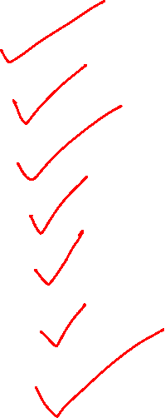
5 of 50 Days of Python Programming
1) Nested-IF
2) Pass Statement
3) Switch Case in Python
4) FOR Loop
5) The Loop Variable
6) The range function
7) Homework: WAP that prints a giant letter A.

Slide 23
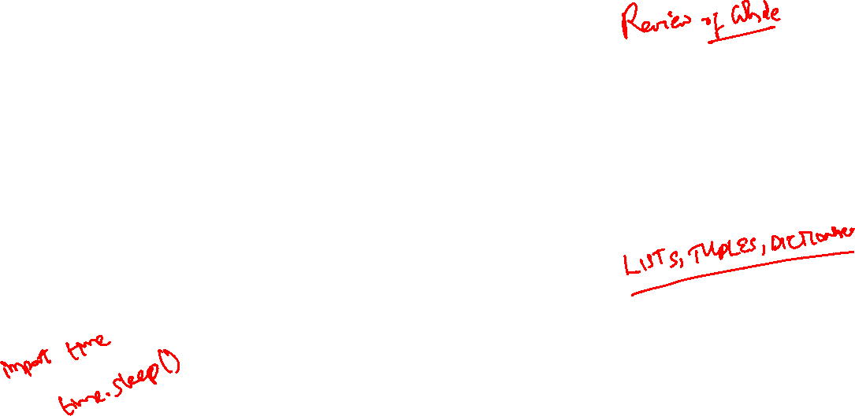
Day 6 of 50 Days of Python Programming
1) Some While Examples
2) Use of sys.exit()
3) Strings (Concatenation and Repetition)
4) Slicing
5) Assignments
Next Class: Read up Functions

Slide 24
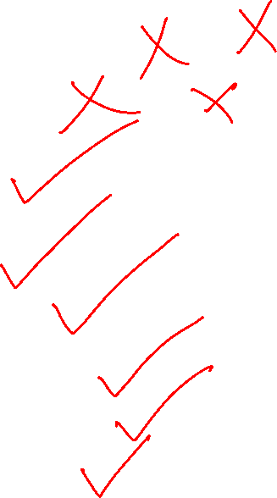
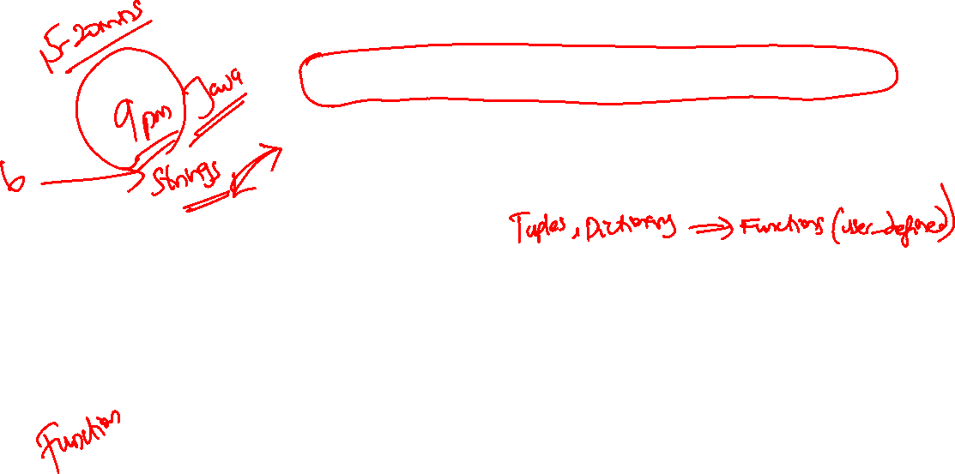
Day 7 of 50 Days of Python Programming
Version control Using Git vs GitHub
Creating an account, cloning etc
Basics of Lists (Input, Empty & Long lists)
Lists vs Strings & built-in functions
List methods
Making copies & changing lists
Demo (Examples)
Homework

Slide 25
Day 7 of 50 Days of Python Programming
Version control Using Git vs GitHub
Creating an account, cloning etc
Basics of Lists (Input, Empty & Long lists)
Random module in list
Lists vs Strings & built-in functions
List methods
Making copies & changing lists
Demo (Examples)
Homework

Slide 26
Day 8 of 50 Days of Python Programming
1. Assignment Revision
2. Git vs GitHub Tutorial
3. Joins (Opposite of Split)
3. List Comprehension
4. Two-Dimensional lists
5. Demo (Examples)
6. Assignments!!

Slide 27
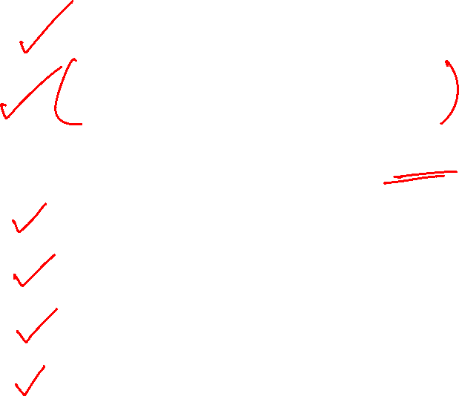
Day 8 of 50 Days of Python Programming
1. Assignment Revision
2. Git vs GitHub Tutorial
3. Joins (Opposite of Split)
3. List Comprehension
4. Two-Dimensional lists
5. Demo (Examples)
6. Assignments!!

Slide 28
Day 9-10 of 50 Days of Python Programming
OUTLINE
Tuples
Sets
Dictionary
Homework

Slide 29
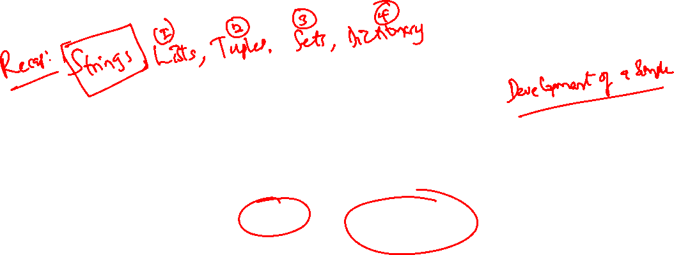
Day 9-10 of 50 Days of Python Programming
OUTLINE
Tuples
Sets
Dictionary
Homework

Slide 30
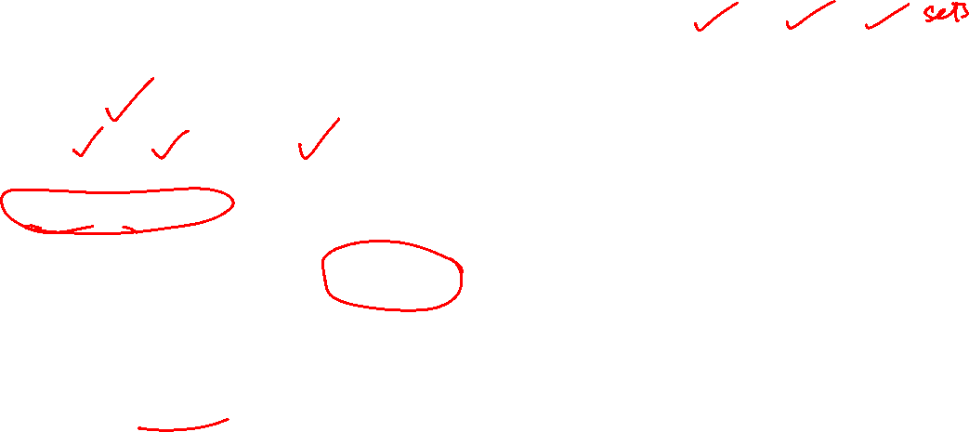
Recap…
The data types that are most used in Python are strings, tuples, lists and dictionaries. These are collectively called data structures.
Strings, tuples, and lists are examples of a particular data model called sequences.
Strings and tuples are immutable, which means that we cannot modify an existing string or tuple.
Lists are mutable, which means we can add or remove items from a list.

Slide 31
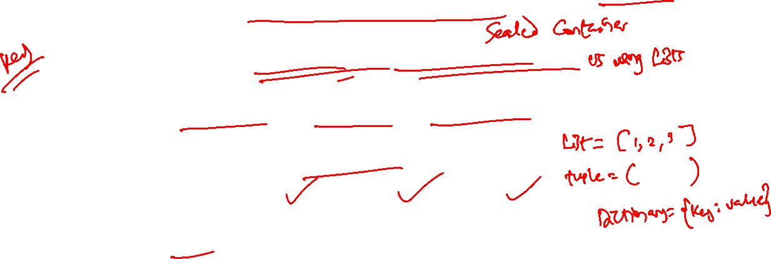
Tuples
A tuple is an immutable ordered group of items or elements. Think of tuples as useful little sealed packets of information.
Tuples are used to store multiple items in a single variable.
A tuple is a collection which is ordered and unchangeable.
Tuples are written with round brackets.
Example: Fruits = ("apple", "banana", “berry") print(Fruits)

Slide 32
Tuples
Allow Duplicates
Since tuples are indexed, they can have items with the same value
Example: Tuples allow duplicate values:
Friuits = ("apple", "banana", "cherry", "apple", "cherry") print(Fruits)
Tuple Length
To determine how many items a tuple has, use the len() function:
Example: print(len(Fruits))

Slide 33

Day 11 of 50 Days of Python Programming
1. Sets-Contd...
2. Dictionary
3. Mini Exercise!!
4. Assignment

Slide 34
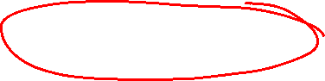
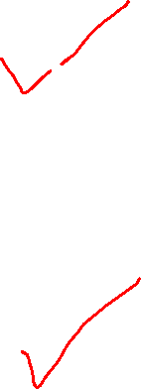
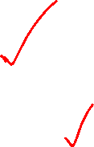
Day 11 of 50 Days of Python Programming
1. Sets-Contd...
2. Dictionary
3. Mini Exercise!!
4. Assignment

Slide 35
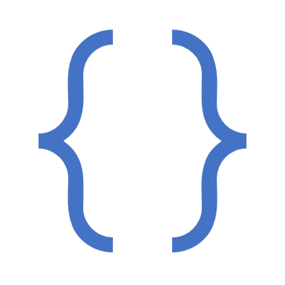
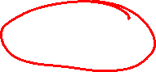
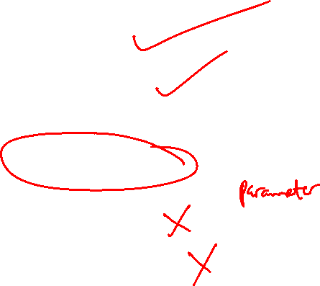
Day 12 of 50 Days of Python Programming
Reading from files
Writing to Files
Examples (Wrt files)
Functions
Function Arguments
Examples (Wrt Functions)

Slide 36

Day 12 of 50 Days of Python Programming
Reading from files
Writing to Files
Examples (Wrt files)
Functions
Function Arguments
Examples (Wrt Functions)

Slide 37
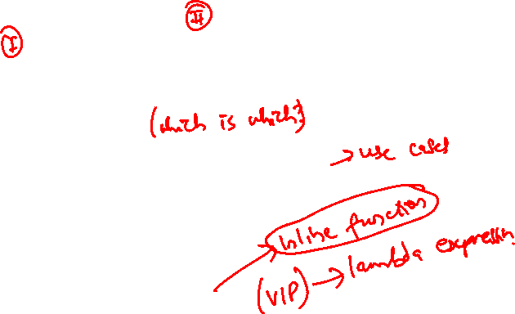
Day 13 of 50 Days of Python Programming
1. Functions
Creating & Calling
2. Function Arguments vs Parameters
Arbitrary Arguments
3. The Pass Statement
4. Recursion
5. Lambda Function
6. Examples (Wrt Lambda Functions)
7. Assignment

Slide 38
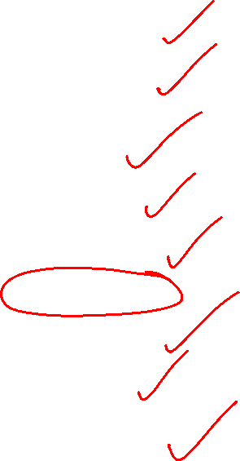

Day 13 of 50 Days of Python Programming
1. Functions
Creating & Calling
2. Function Arguments vs Parameters
Arbitrary Arguments
3. The Pass Statement
4. Recursion
5. Lambda Function
6. Examples (Wrt Lambda Functions)
7. Assignment

Slide 39
Day 14 of 50 Days of Python Programming
Missing Notes?
Python Recursion: What and Why use it?
Advantages and Disadvantages
Recursion Examples

Slide 40


Day 14 of 50 Days of Python Programming
Missing Notes?
Python Recursion: What and Why use it?
Advantages and Disadvantages
Recursion Examples

Slide 41

Day 15 of 50 Days of Python
1. Object Oriented Programming
2. Creating your own classes
3. Inheritance
4. Mini Projects
5. Homework

Slide 42


Day 15 of 50 Days of Python
1. Object Oriented Programming
2. Creating your own classes
3. Inheritance
4. Mini Projects
5. Homework

Slide 43
Day 16 of 50 Days of Programming
1. Classes - contd
2. Scopes and Namespaces in Python
3. Class Definition and Objects
4. Instance of a class
5. Method Objects
6. Python Iterators
7. Generators
8. Generator Expressions
10. Homework

Slide 44

Day 16 of 50 Days of Programming
1. Classes - contd
2. Scopes and Namespaces in Python
3. Class Definition and Objects
4. Instance of a class
5. Method Objects
6. Python Iterators
7. Generators
8. Generator Expressions
10. Homework

Slide 45

Day 17-18 of 50 Days of Programming
1. Errors vs Exceptions
2. Catching Exceptions using Try and Except
3. Catching Specific Exceptions
4. Try & Else Clause
5. Finally Keyword in Python
6. Raising Exceptions

Slide 46


Day 17-18 of 50 Days of Programming
1. Errors vs Exceptions
2. Catching Exceptions using Try and Except
3. Catching Specific Exceptions
4. Try & Else Clause
5. Finally Keyword in Python
6. Raising Exceptions

Slide 47
Day 19 of 50 Days of Programming
1. Finding Patterns with Regular Expressions (RE)
2. Regular Expression Matching: A Review
3. Matching Multiple Groups with the pipe (|) Character
4. Matching with the Question Mark (?)
5. Matching Zero or more characters (*)
6. Matching One or More characters (+)
7. Matching Specific Repetitions with Curly Brackets{}
8. Character Classes

Slide 48

Day 19 of 50 Days of Programming
1. Finding Patterns with Regular Expressions (RE)
2. Regular Expression Matching: A Review
3. Matching Multiple Groups with the pipe (|) Character
4. Matching with the Question Mark (?)
5. Matching Zero or more characters (*)
6. Matching One or More characters (+)
7. Matching Specific Repetitions with Curly Brackets{}
8. Character Classes

Slide 49
Day 20 of 50 Days of Python
Regular Expressions - Missing Notes
1. The search() Function
2. The split() Function
3. The sub() Function
4. The Match Object
5. The string() Function

Slide 50

Day 20 of 50 Days of Python
Regular Expressions - Missing Notes
1. The search() Function
2. The split() Function
3. The sub() Function
4. The Match Object
5. The string() Function

Slide 51

Day 20 of 50 Days of Python
GUI Programming using Tkinter
1. Basics of a GUI Program
2. Tkinter Widgets
3. Widget Classes
4. Geometry Management
5. Tkinter Button
6. Themed Widgets
7. Tkinter Labels

Slide 52
Anything Else?

